Slide 1
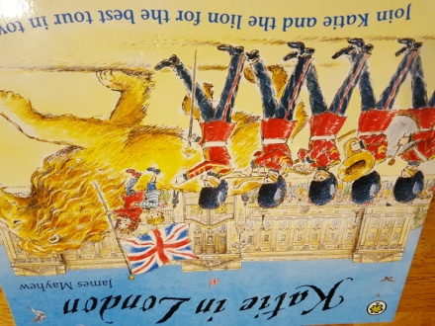

The title of this book is Katie in London.
The author of the book is James Mayhew.

Slide 2

On the cover I can see ……
I think the setting is .........
I think the main characters in this story are .....
I predict that in this story …..
I think ….. because .....
I wonder why ……

Slide 3
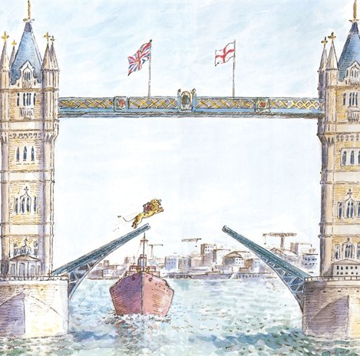
Challenge:
Can you think of some questions that you might want to ask about this book?
Now watch the story: https://www.youtube.com/watch?v=2Q1GszEknDI

