Slide 1
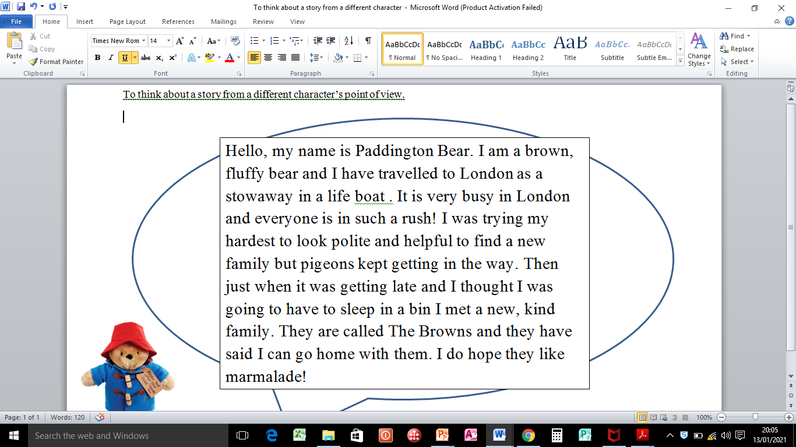
Click here for explanation of lesson.

