Slide 1

Adding the suffix ‘ful’
A suffix is a group of letters that go at the end of the word and change the meaning.
We can add the suffix -ful to make new words too. Adding ful changes a noun to an adjective (a describing word for a noun). For example: joy becomes joyful.
There’s a spelling rule for adding the suffix -ful too. If the word ends in a consonant + y, change the y to an i before you add -ful. For example: beauty becomes beautiful.

Slide 2
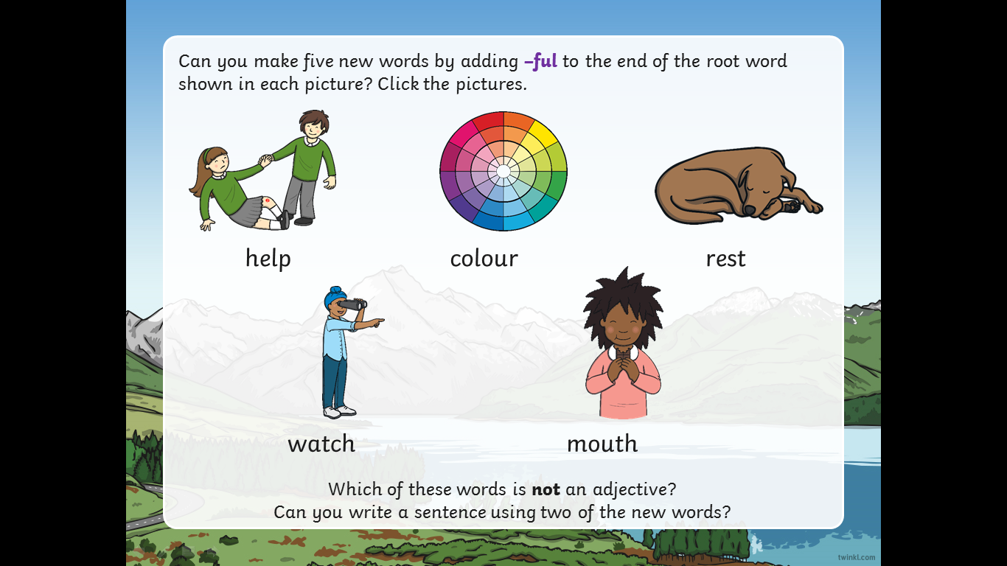

Slide 3
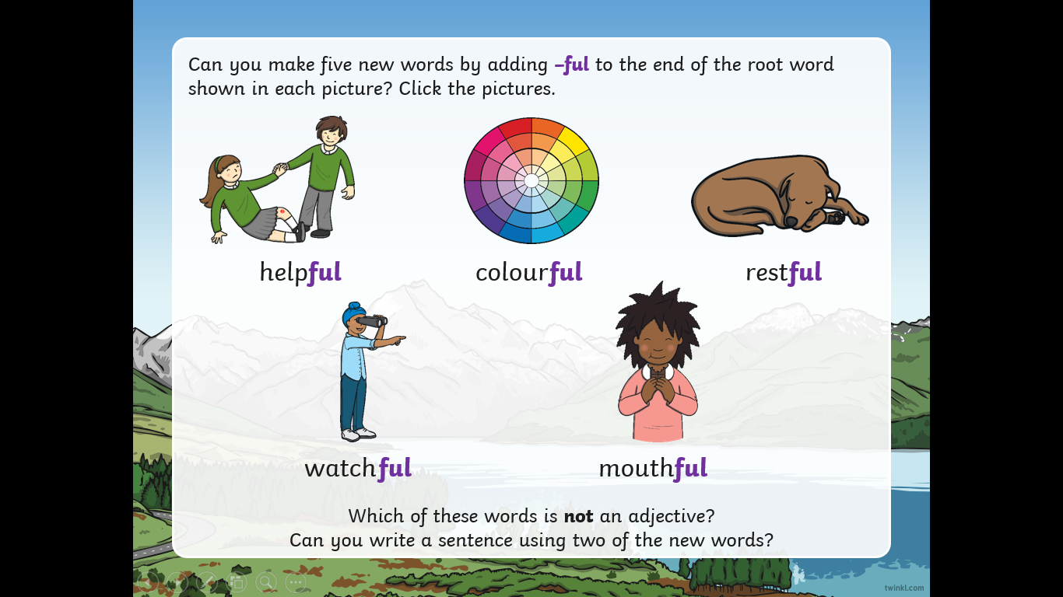

Slide 4
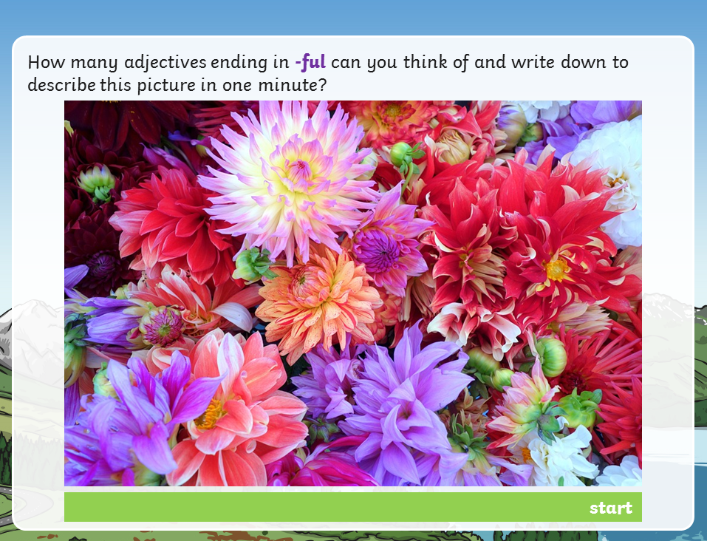

Slide 5
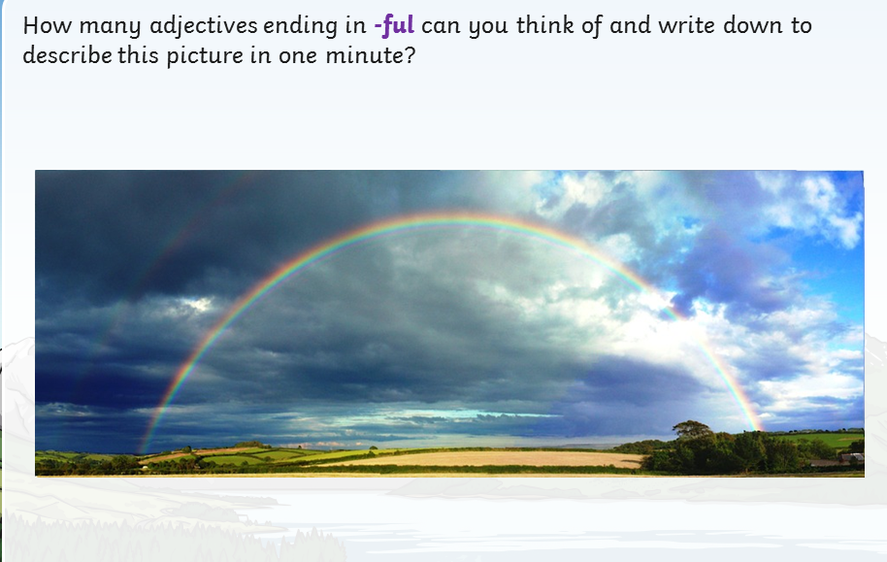

Slide 6
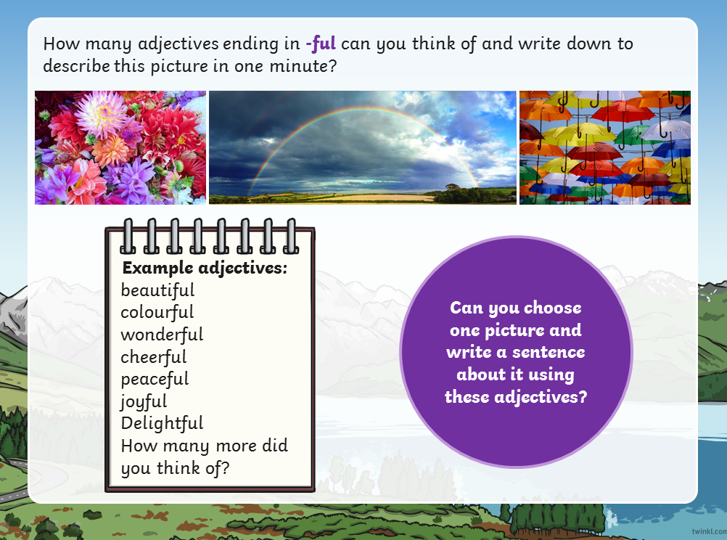

Slide 7
Monday’s Activity
Using the suffix ‘ful’
Read the words in the table below then write them out, adding the suffix -ful.
Top tip: Make sure you added ‘ful’ and not ‘full’. You only need one 'l'.
word | add -ful
hope
care
wonder
success
help
power
colour

Slide 8
Tuesday’s Activity
Now read the definitions below.
Can you match up the -ful words you’ve made with their meanings?
1. When someone has succeeded at something.
2. Something full of wonder.
3. Something with a lot of colour.
4. Someone with a lot of power.
5. Somebody full of hope.
6. When someone tries not to make any mistakes.
7. Someone who helps a lot.

