Slide 1

Adding the suffix ‘less.’
A suffix is a group of letters that go at the end of the word and change the meaning.
We can add the suffix -less to make new words too. It makes the word means that it is without something e.g pain to painless.

Slide 2
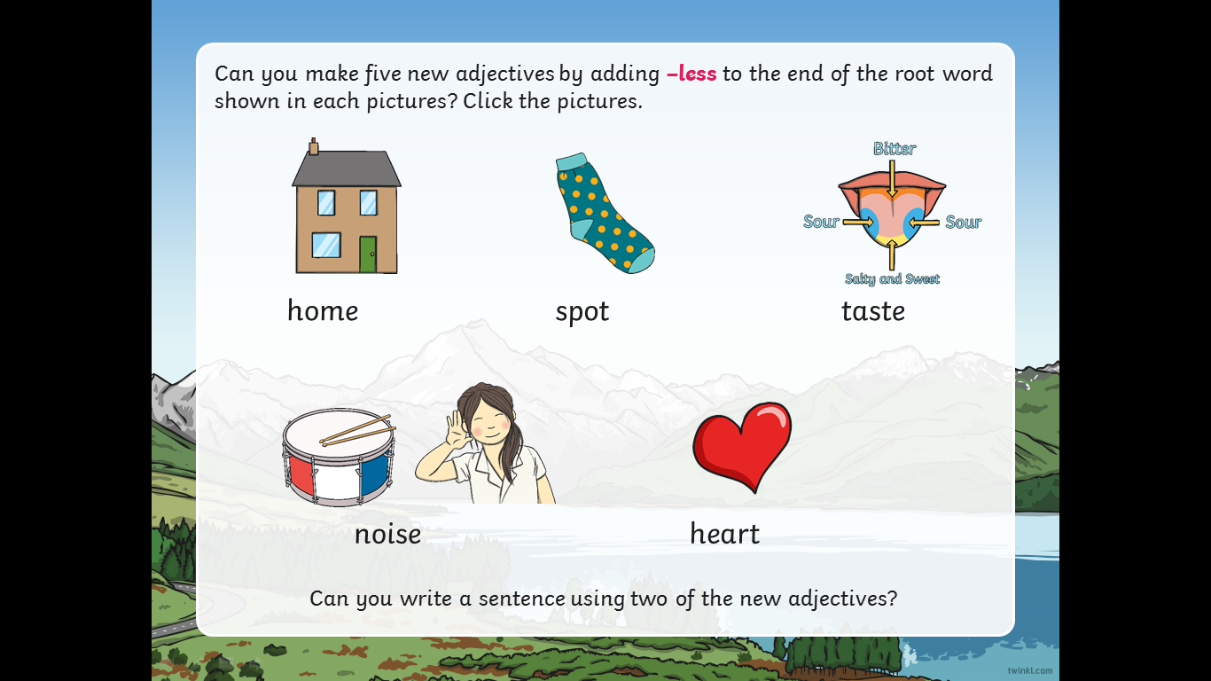

Slide 3
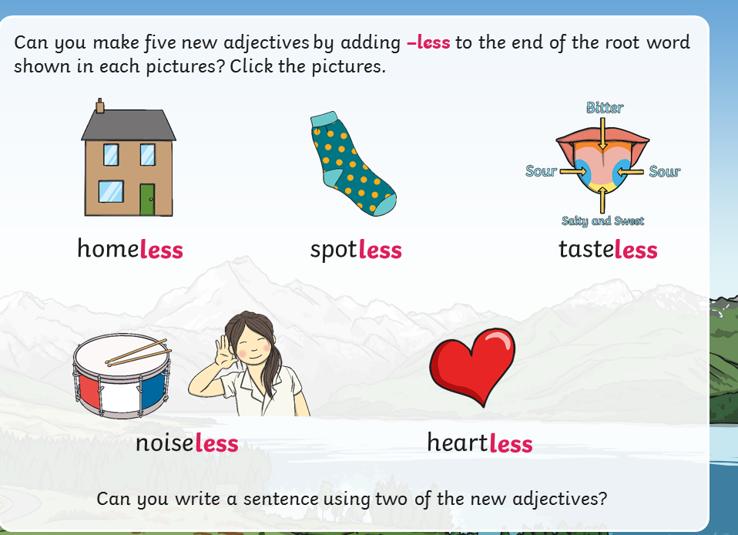

Slide 4
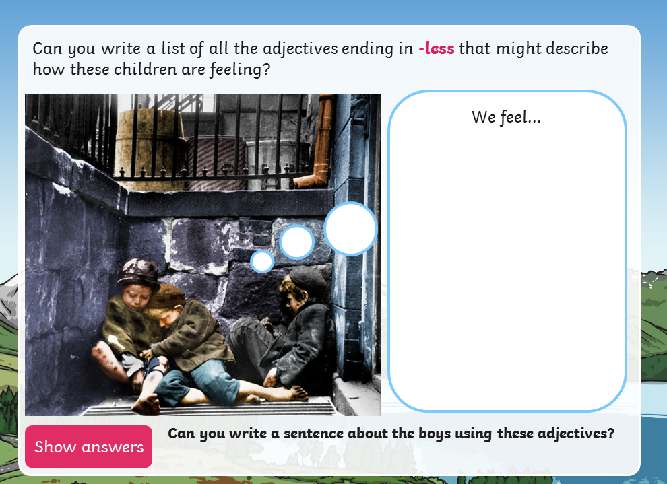

Slide 5
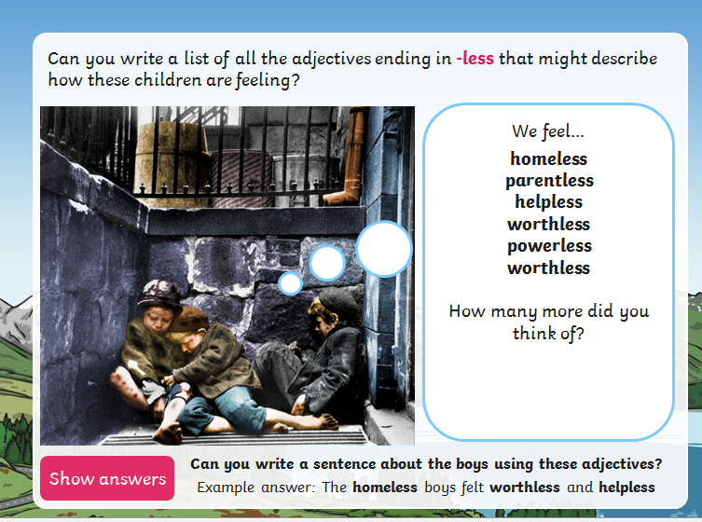

Slide 6
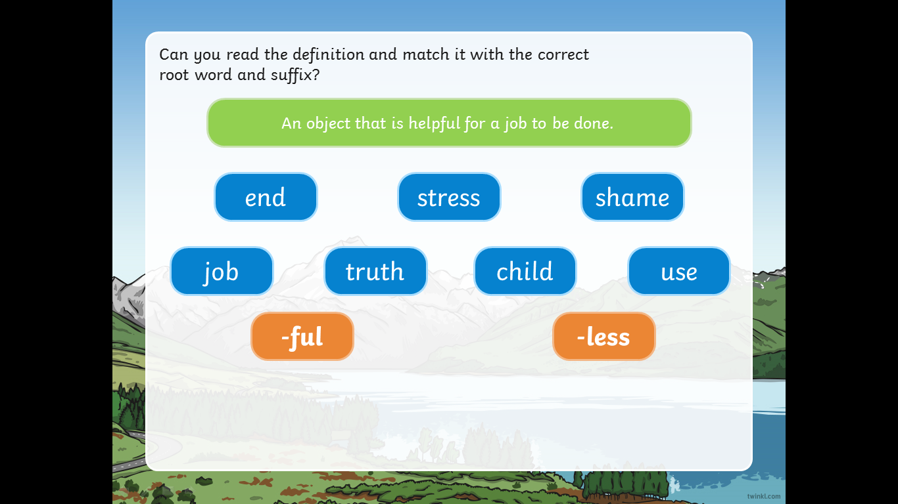

Slide 7


Slide 8


Slide 9


Slide 10
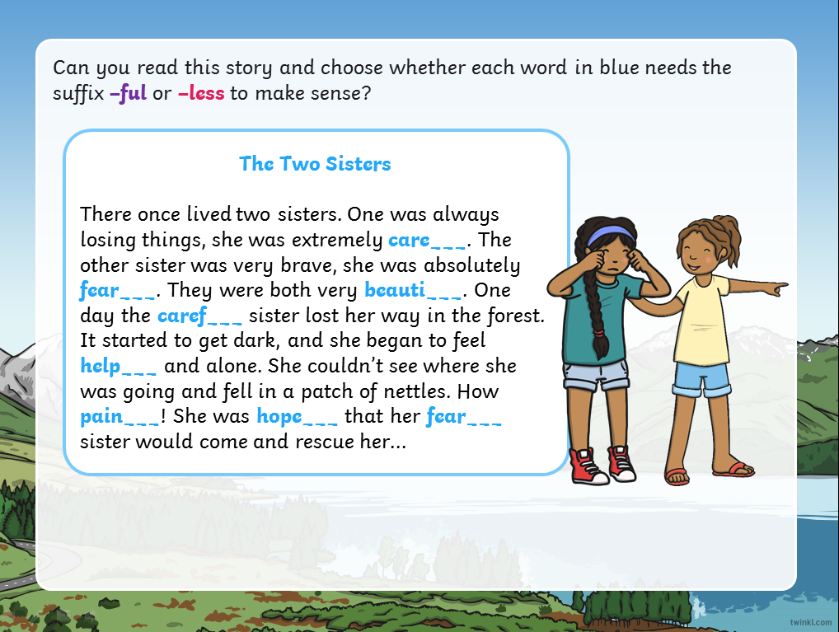

Slide 11
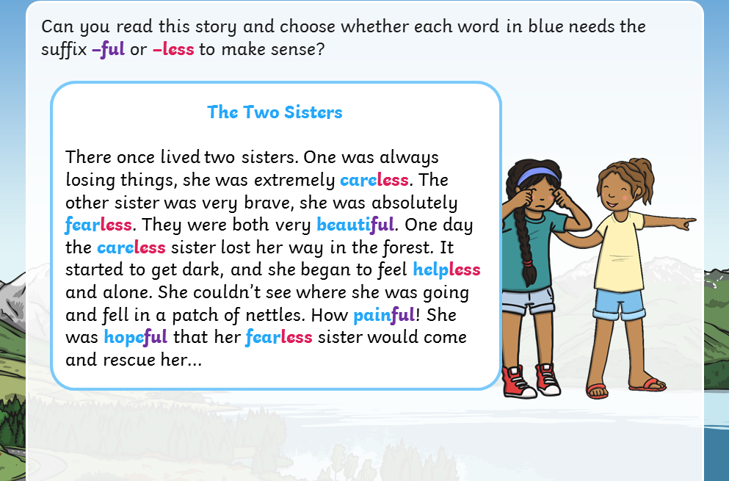

Slide 12
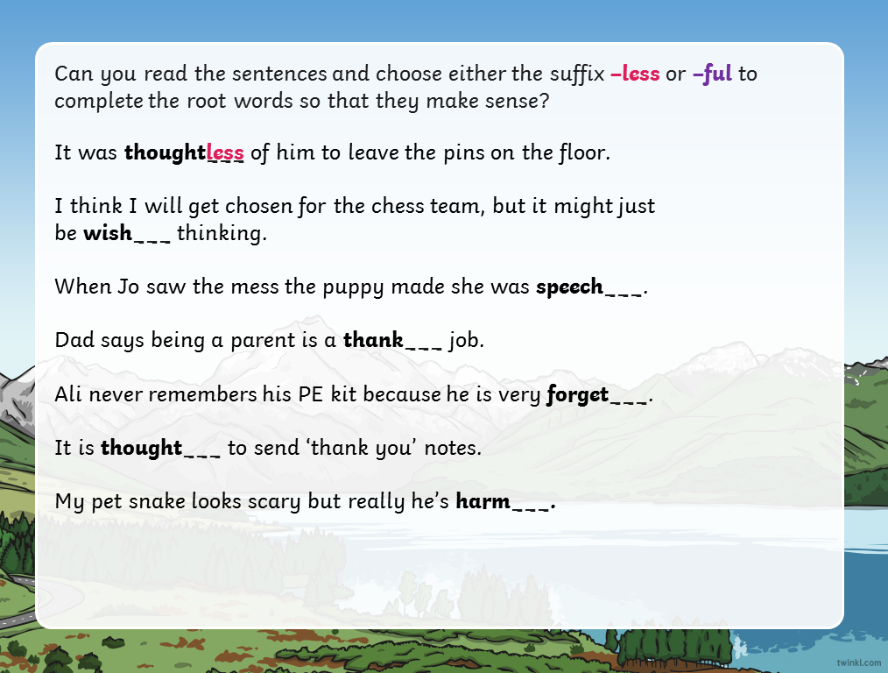

Slide 13
