Slide 1
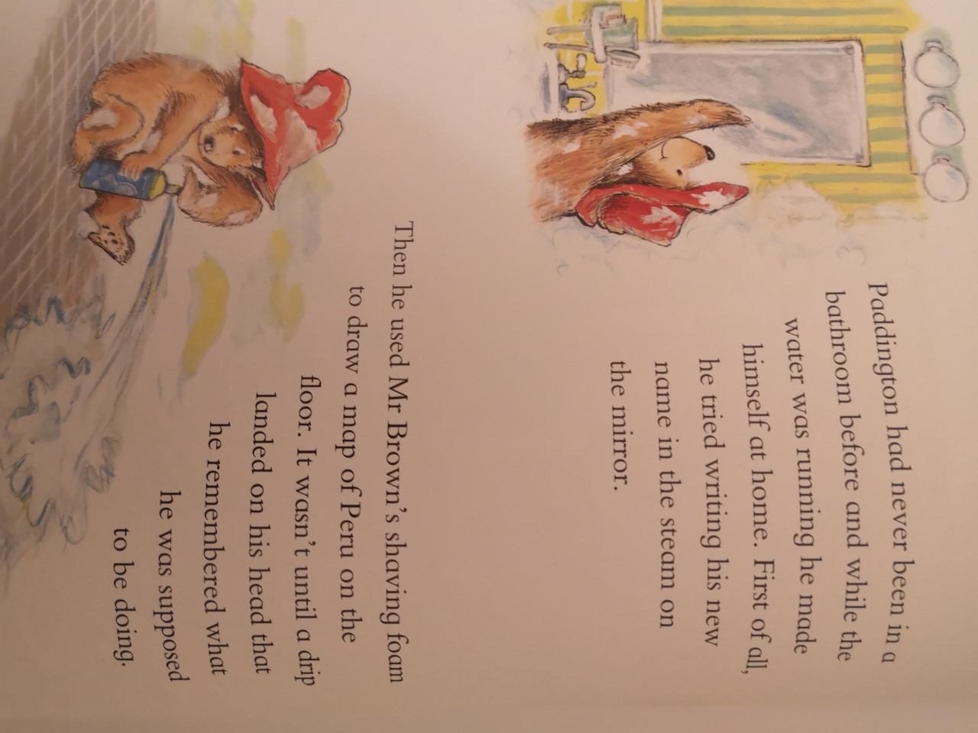


Slide 2
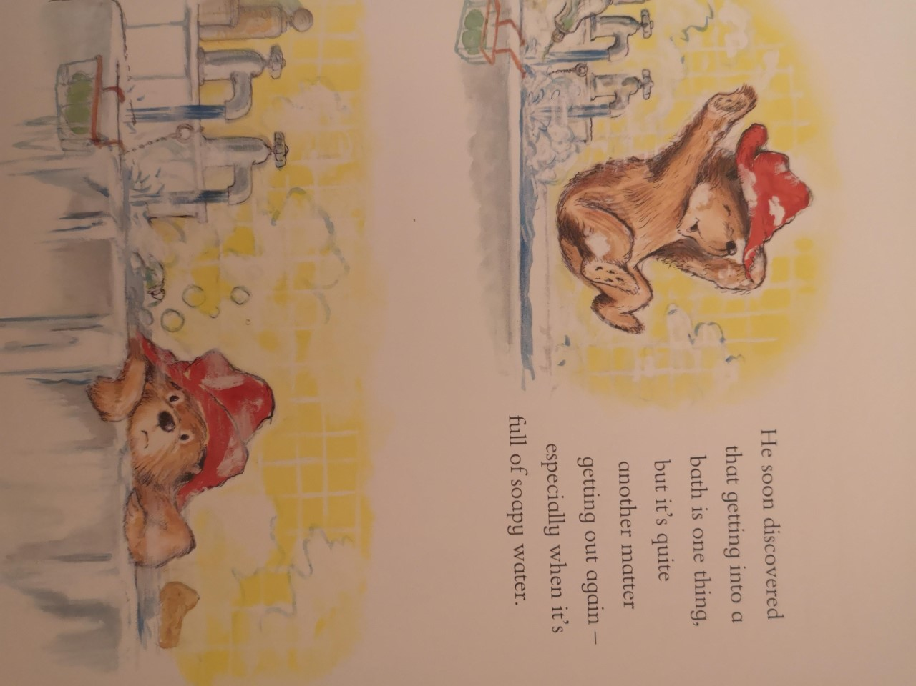

Slide 3
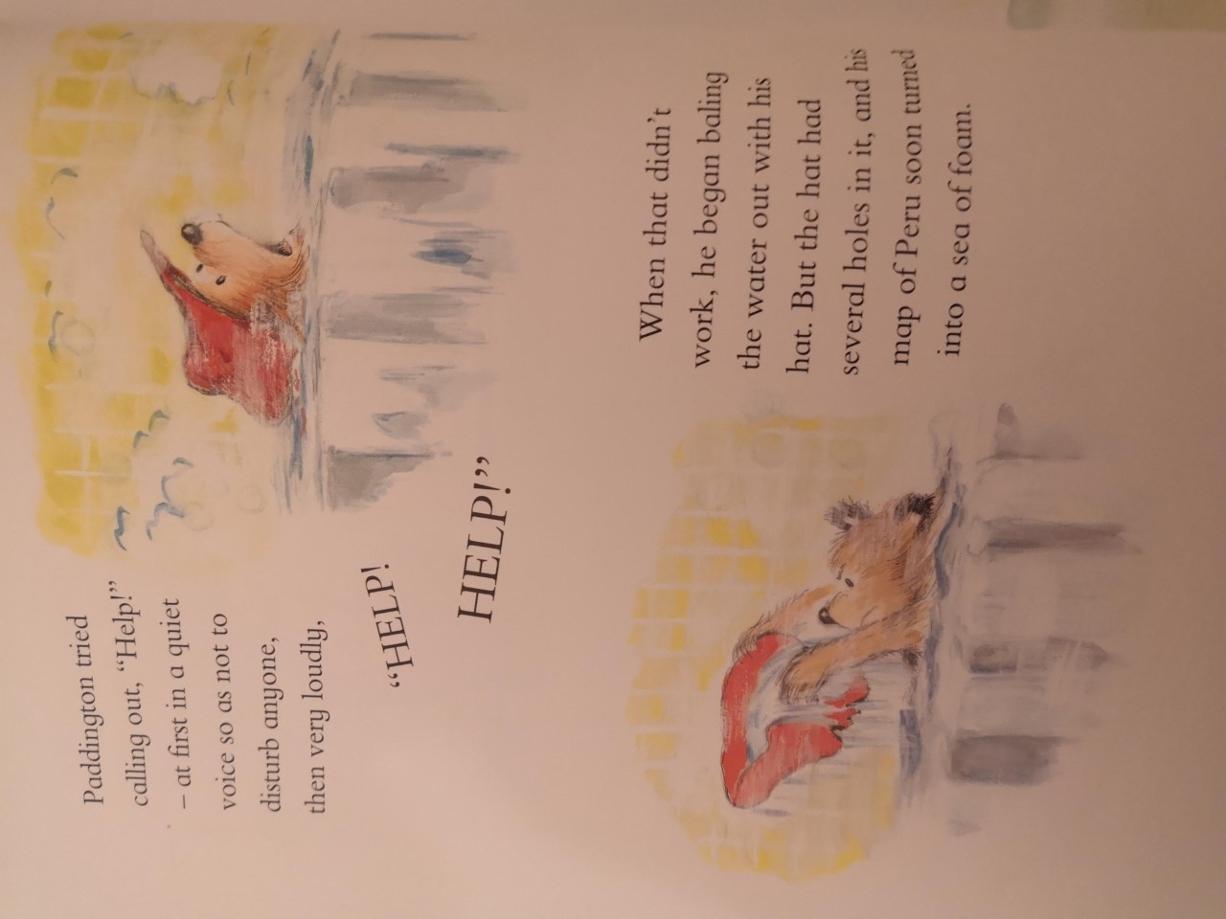

Slide 4
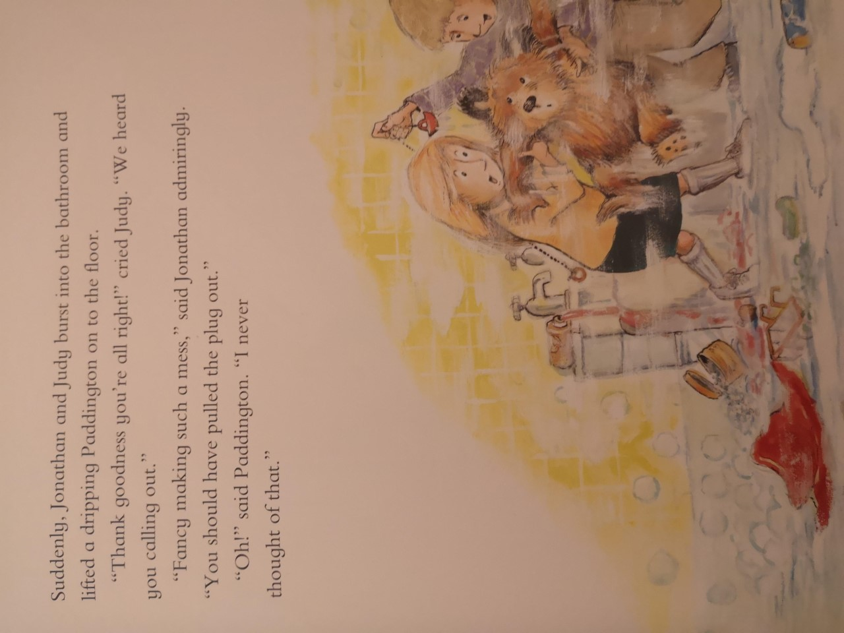

Slide 5
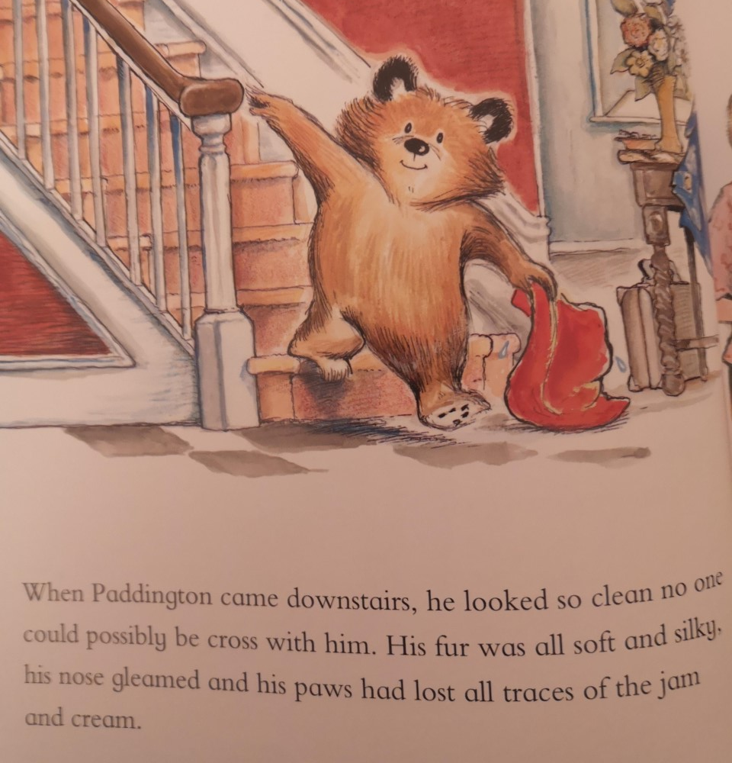

Slide 6
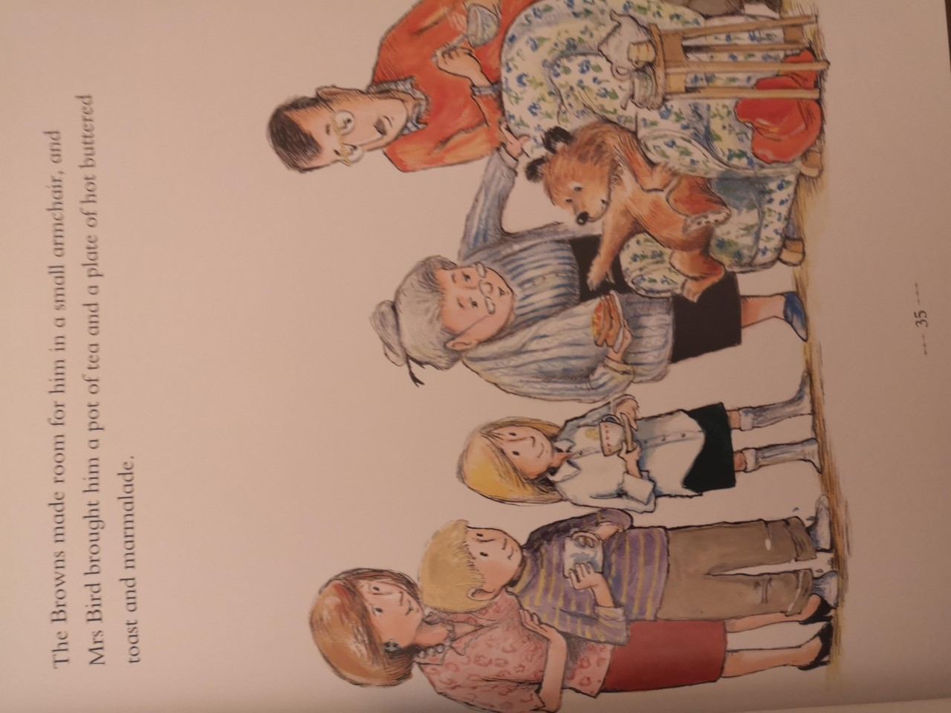

Slide 7
Sentence openers that you could use in your work:
First
Then
Next
After that
Suddenly
Finally

Slide 8
Example of Recount to help you
Paddington had never had a bath before. First, he tried writing his name in the mirror. Then, he drew a map of Peru using Mr Brown’s shaving foam. Next, he clambered into the slippery, bubbly bath. After that, he realised that he couldn’t get out and started to shout “HELP!” But that didn’t work so he started scooping water out with his hat. Suddenly, Judy and Jonathan burst in and helped Paddington, they couldn’t believe the mess he made! Finally, Paddington came downstairs, he looked so soft and silky and his nose gleamed. No one could be cross at him and they all sat down for a cup of tea and some toast with marmalade.

